Slide 1
Front End Engineering-I Project
Team Details:
Rahul (2210990703)
Rahul Singh (2210990704)
Rajat Gupta (2210990705)
Rajat Saini (2210990706)
Faculty Coordinator: Dr.Mandeep Kaur
Chitkara University Institute of Engineering and Technology, Chitkara University, Punjab

Slide 2
Table of Contents
Introduction
Problem Statement
Technical Details
Key Features
Code
Solution
Conclusion
References/Links used

Slide 3
Introduction
NOTE LOG
This Project is Created By :
Rahul
Rahul Singh
Rajat Gupta
Rajat Saini
PURPOSE
Records the essence of the information, freeing their mind from having to recall everything.
To Remove the overload of carrying the information .
GOAL
To help us to understand and retain essential information.

Slide 4
Problem Statement
The primary purpose of a Notelog is to provide users with a digital platform to write down and organize their thoughts, ideas, and information. Whether it's taking notes during a meeting, brainstorming ideas, making a to-do list, or any other purpose, a notepad offers a simple and efficient solution to the problem of organizing and managing information.
A notelog provides a focused and distraction-free interface for users to take notes, make lists, or note down ideas. It aims to address the challenges of information overload and the difficulty of keeping track of important information by providing a tool that is easy to use and always accessible.

Slide 5
Technical Details
Notelog is a simple application that can be created using HTML and CSS.
HTML is used for the structure and content of the page,
while CSS is used for styling and layout.
To create a notelog using HTML and CSS, the first step is to create a basic HTML structure that includes the necessary elements for a notepad, such as a text area, buttons, and input fields. Then, CSS is used to style the notepad, including the fonts, colors, and layout.
Although ,the Javascript is used for the purpose of popups and hover

Slide 6
Key Features
To solve the problem of notelog, there are several key features that are essential. These include:
1.Simplicity: A notelog should be simple and easy to use, with an intuitive
interface that allows users to quickly capture and organize their thoughts. 2.Accessibility: A notelog should be easily accessible, whether through a web- based application or a downloadable app that can be installed on various devices.
Customization: A notelog should allow users to customize the appearance and functionality of the app, such as the ability to change the font size or color scheme.
Syncing: A notelog should have the ability to sync notes across different devices and platforms, ensuring that users can access their notes from anywhere.
Security: A notelog should be secure, with features such as encryption and
password protection to ensure that sensitive information is kept safe.

Slide 7
Types Of the Note Log:
Traditional paper Note logs
Digital Note logs
Hybrid Note logs
Specialized Note logs for specific purposes
Etc………………………………………

Slide 8
Advantages of Using a Notelog
Enhances memory retention
Increases productivity
Improves focus and attention
Enables easy access to information

Slide 9
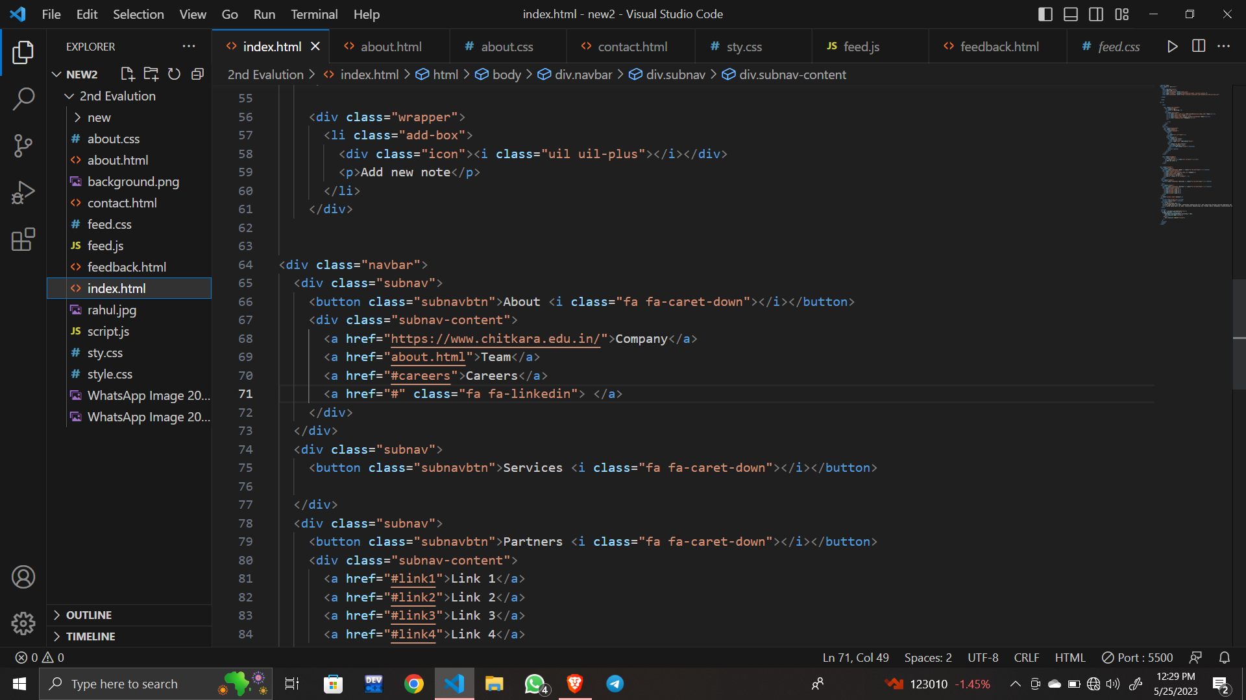
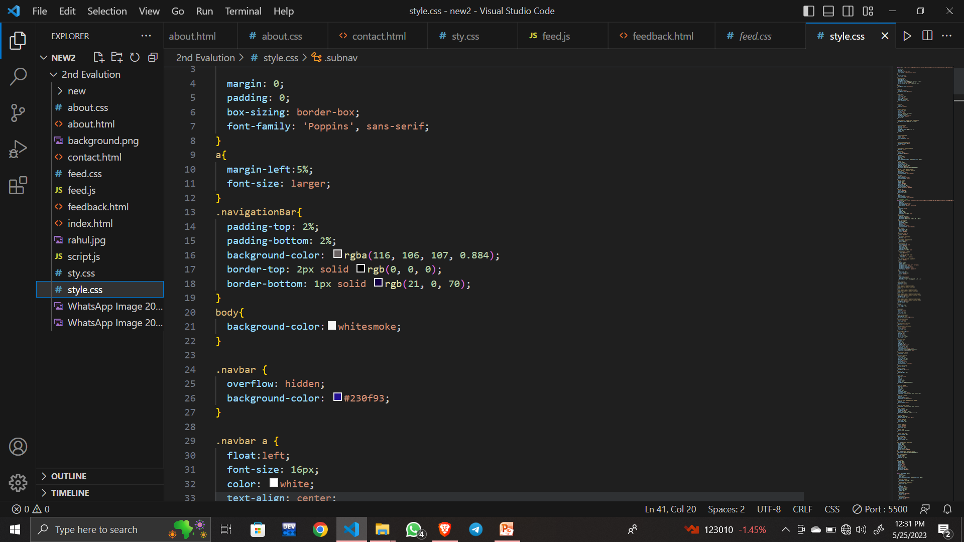
CODE

Slide 10
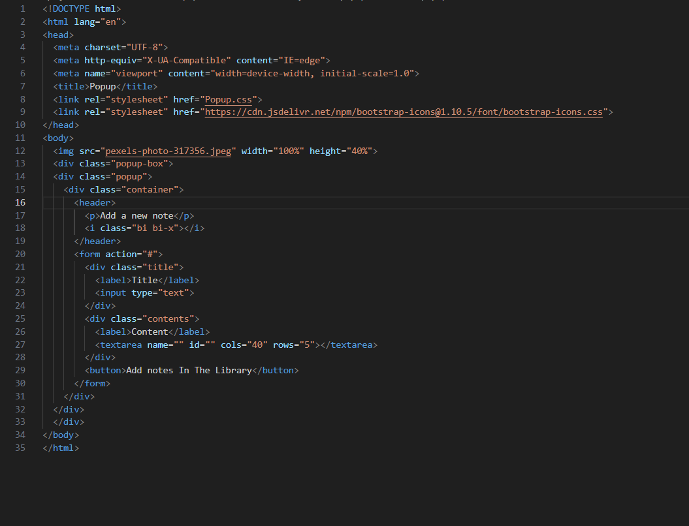
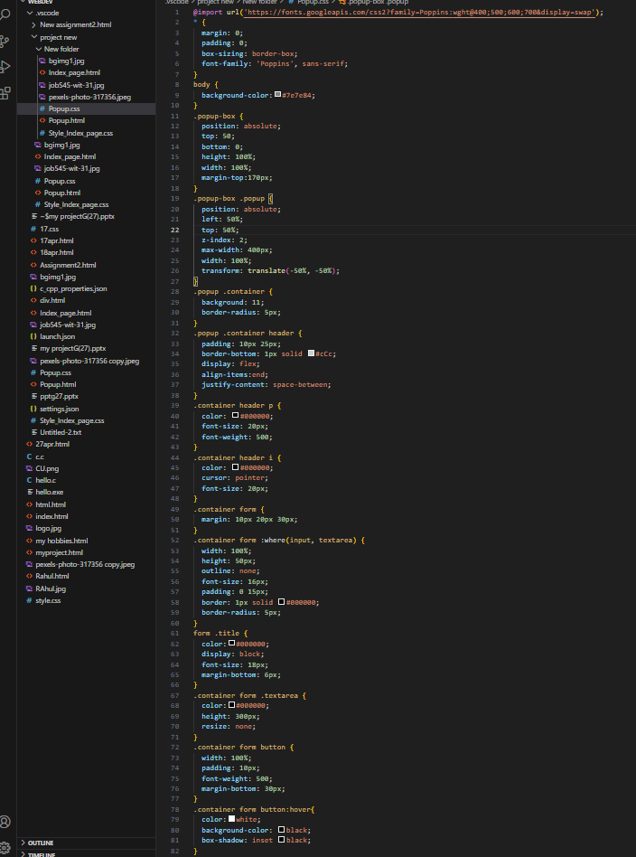

Slide 11
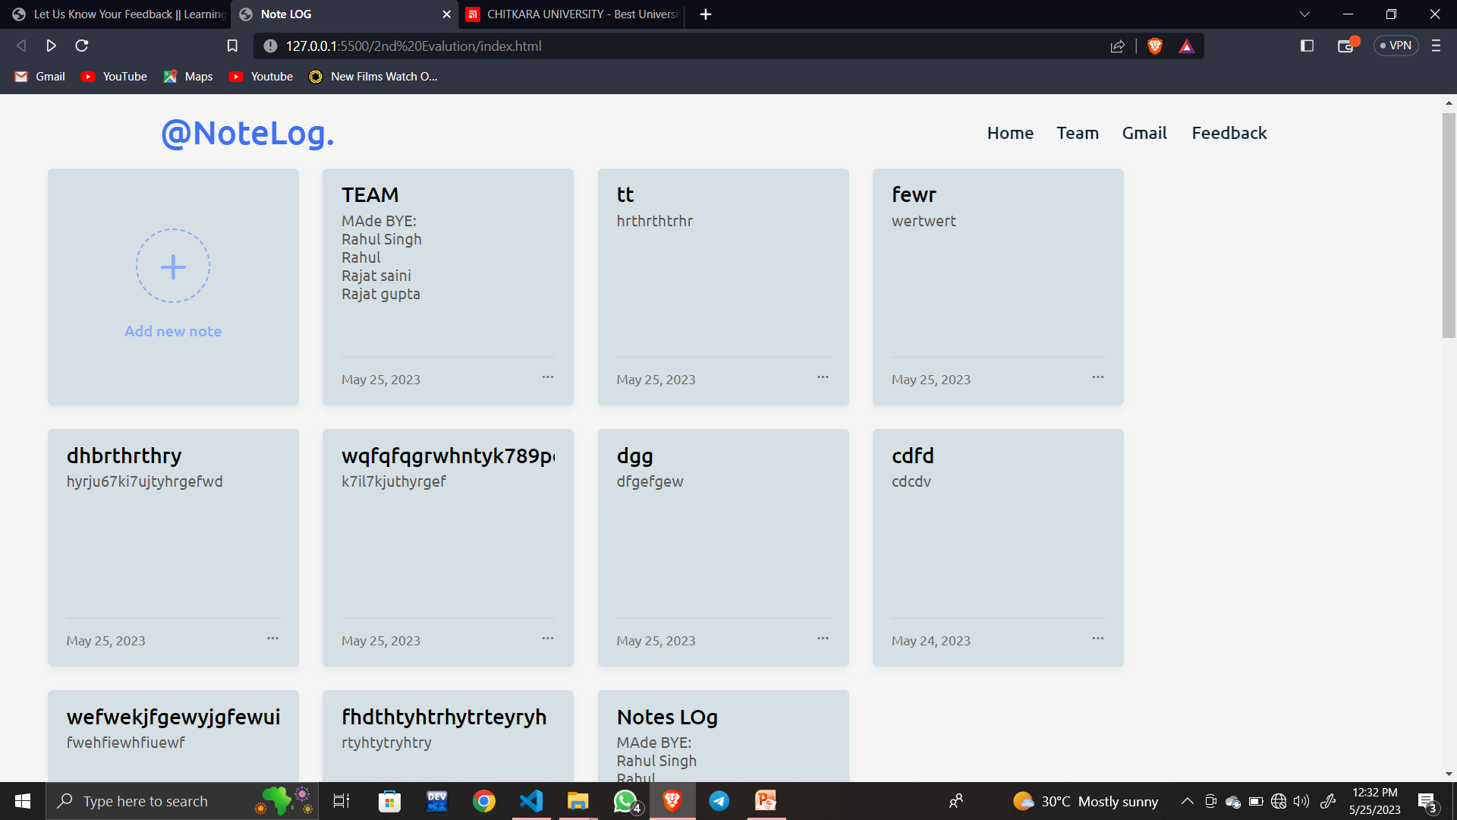
Solution

Slide 12
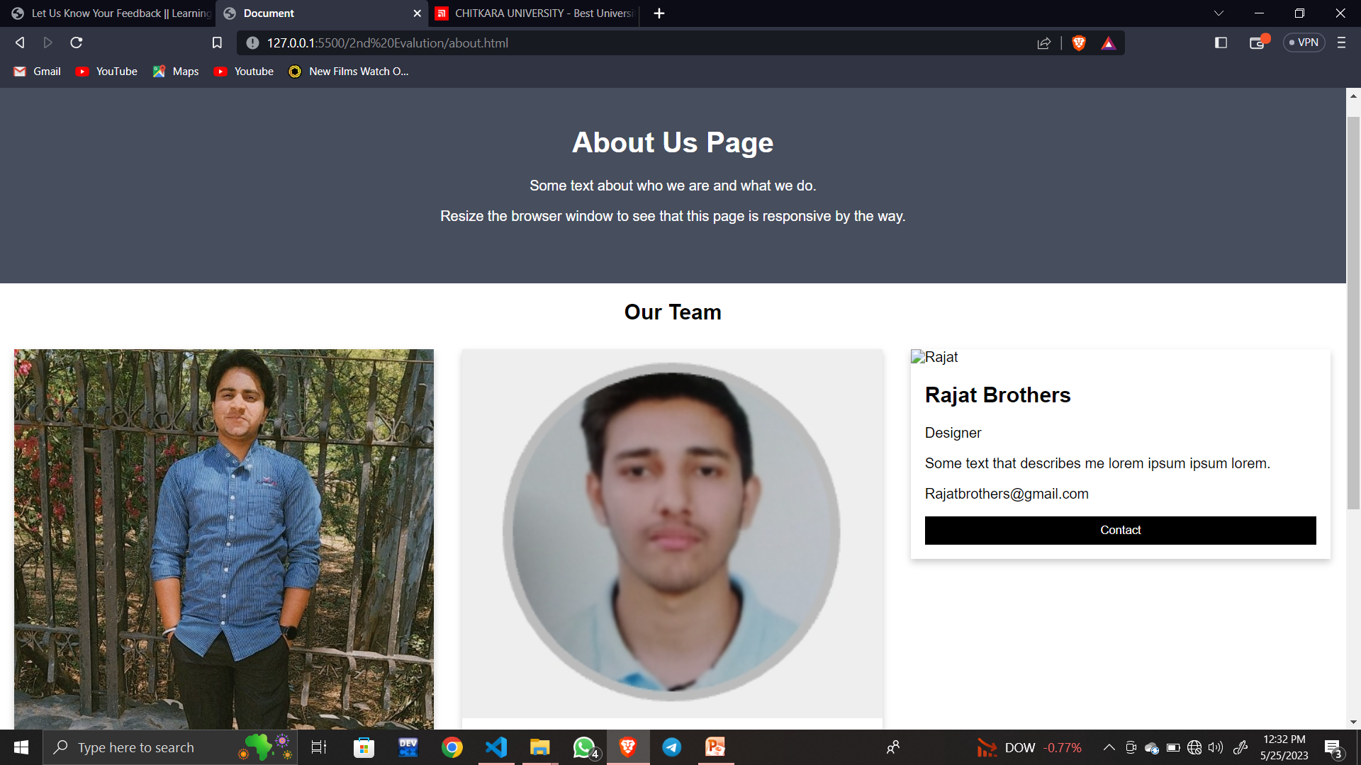
Solution

Slide 13
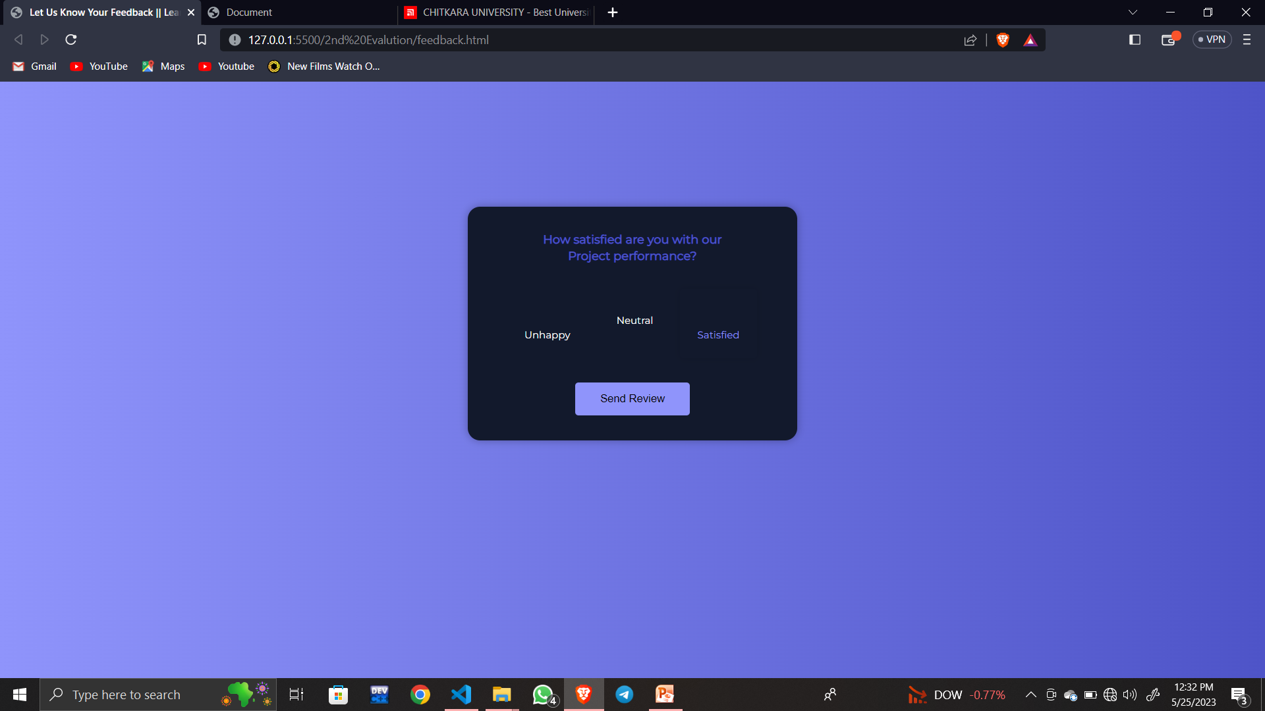

Slide 14
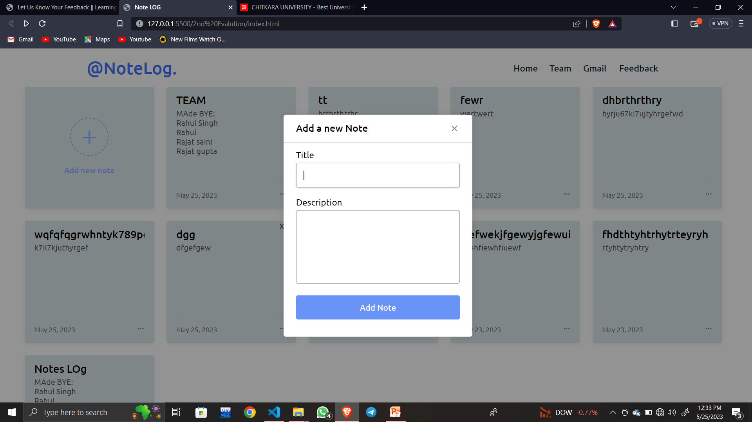

Slide 15
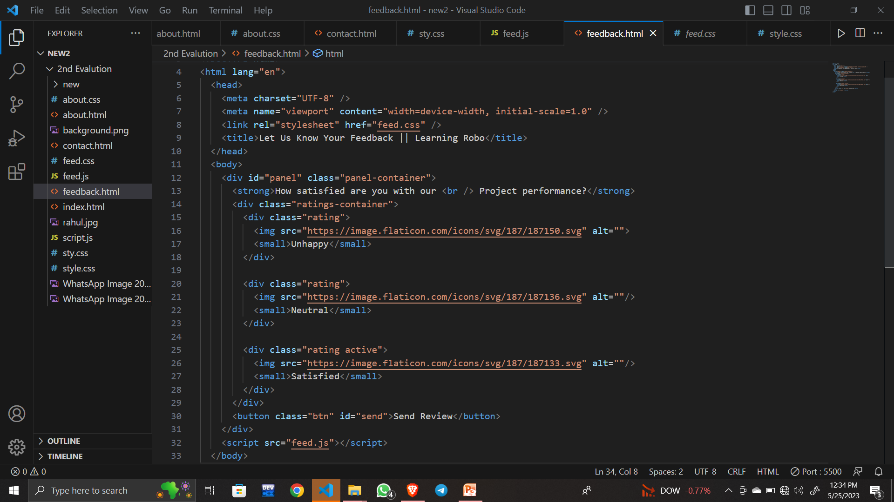

Slide 16
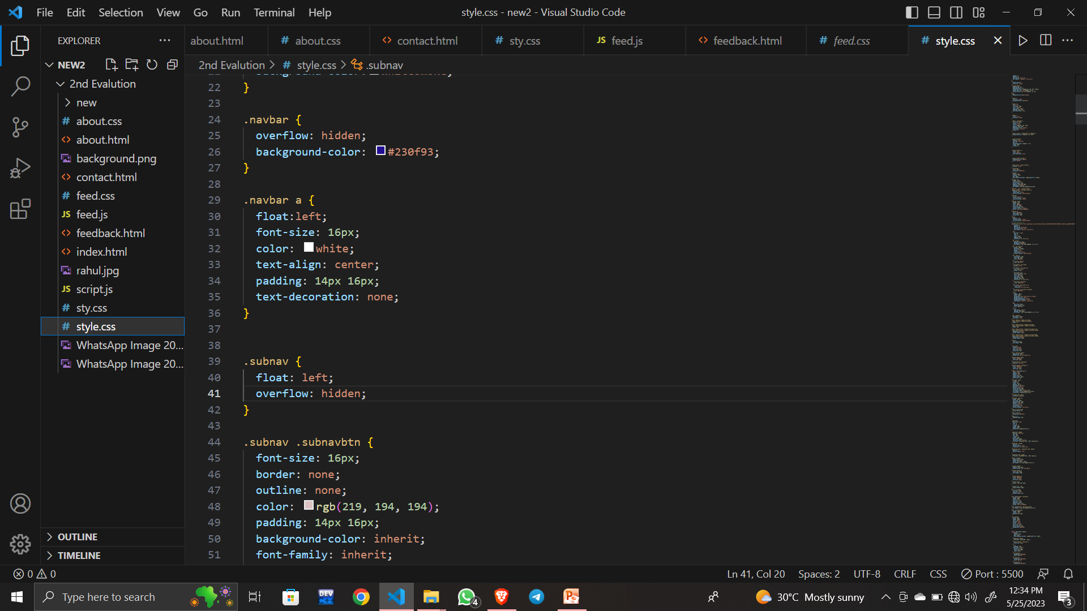

Slide 17
Conclusion
A Notelog is a simple and efficient tool designed to help users capture and organize their thoughts and ideas quickly and easily. It aims to solve the problem of information overload by providing a focused and distraction-free interface that allows users to concentrate on their notes without getting distracted by unnecessary features or cluttered interfaces.
Notelog can be created using various technologies such as HTML, CSS, and JavaScript.
The key features of a notelog include simplicity, accessibility, customization, syncing, security, organization, and search functionality.

Slide 18
References/Links used
HTML ,CSS and JS tutorial from class lectures
Facts from GOOGLE.
WWW.Youtube.com

Slide 19


